Slide 1
E91 Quantum Key Distribution Network
Distributing Crypto Keys with QuTech hardware and an interface server

Slide 2









Structure of the network
$$A_{2}$$
$$A_{1}$$
$$B_{2}$$
$$B_{1}$$
$$A_{3}$$
$$B_{3}$$

Slide 3
Simplifications
Currently we must use a common interface to access the Quantum Computer
We must assume the connection between client and Interface is secure, even though it can be classically secure at best

Slide 4
How does the distribution work?[2]
Two Users establish a connection with the interface server
Users send the server basis in which to measure the Bell-State
The Results are returned to the corresponding users
The Users send each other the used basis (after the measurements have taken place)
If they used the same basis, the measure bit is added to the key
Otherwise, it is sent to the other user
Both users can now use the bits, which aren’t part of the key to validate, whether someone was eavesdropping using Bell’s theorem

Slide 5
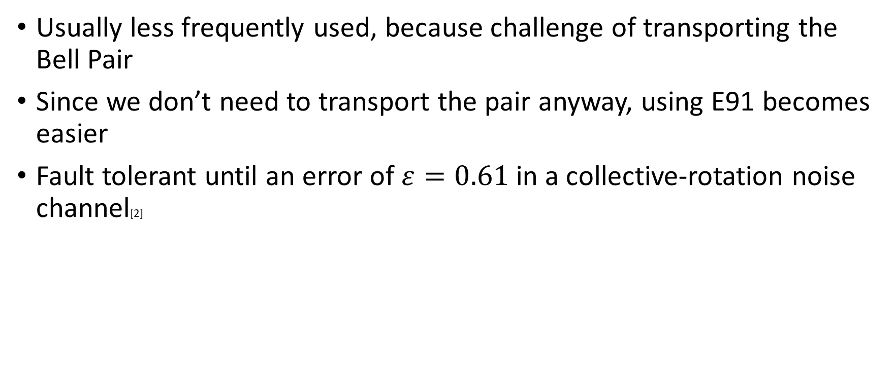
Why E91?
Usually less frequently used, because challenge of transporting the Bell Pair
Since we don’t need to transport the pair anyway, using E91 becomes easier
Fault tolerant until an error of $ε=0.61$ in a collective-rotation noise channel[2]

Slide 6
Limitation and Circumvention
Lack of Quantum Channel
Quantum Key Distribution use of quantum channel to transport qubits from different users
Assumption on Quantum Channel
No multiple measurements in one circuit –> every potential key bit is a new experiment
Very slow
Resource draining
Noise can appear as evesdropping

Slide 7
Analysis

Slide 8
Summary
Interface Server was implemented using Python’s Socket
Interface Server communication
GUI is developed
Can list the current computers on the network
User get to request other users for pairing
After pairing, the pair can request key by sending the basis

Slide 9
Sources
[1]: Ekert AK. Quantum cryptography based on Bell’s theorem. Phys Rev Lett 1991; 67(6): 661.
[2]: Li L, Li H Chen X, Chang Y, Yang Y and Li Jian. The security analysis of E91 in collective-rotation noise channel. International Journal of Distributed Sensor Networks 2018, Vol. 14.

